Slide 1
Version Control Using Git and GitHub

Slide 2
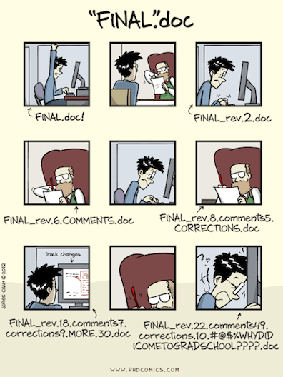
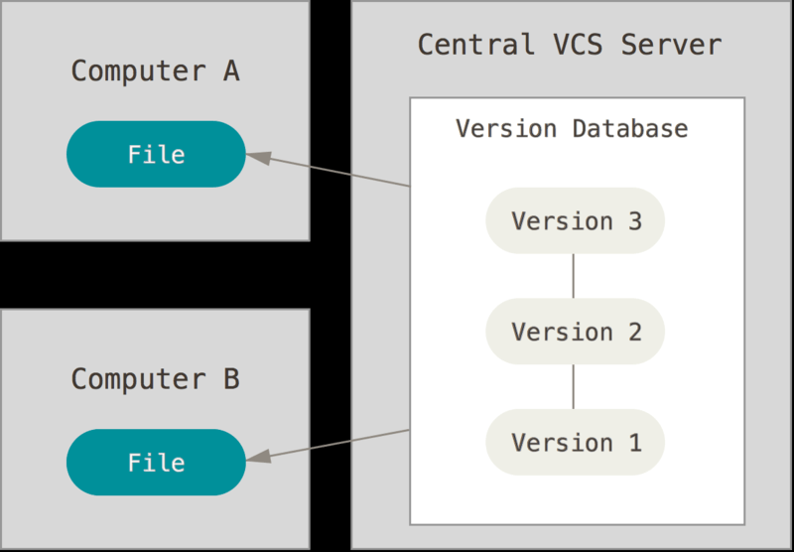
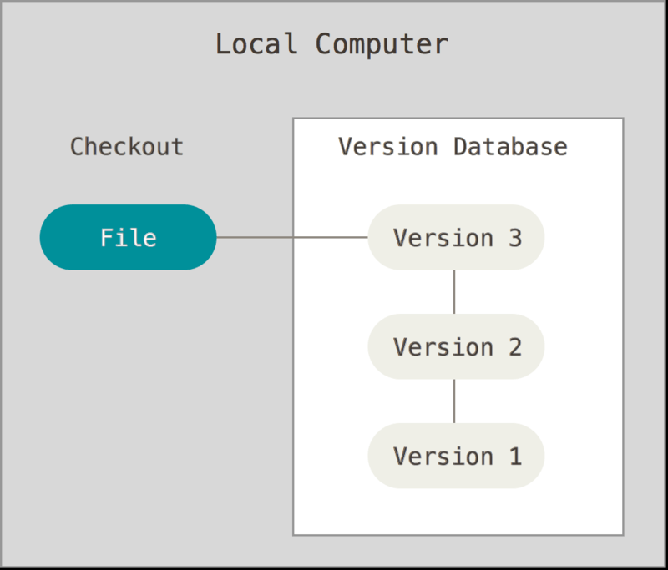
Version Control
Why use Version Control?
Collaboration
Reproducibility
Transparency
Peace of Mind (Backup and Experimentation)
Notes and Feedback

Slide 3
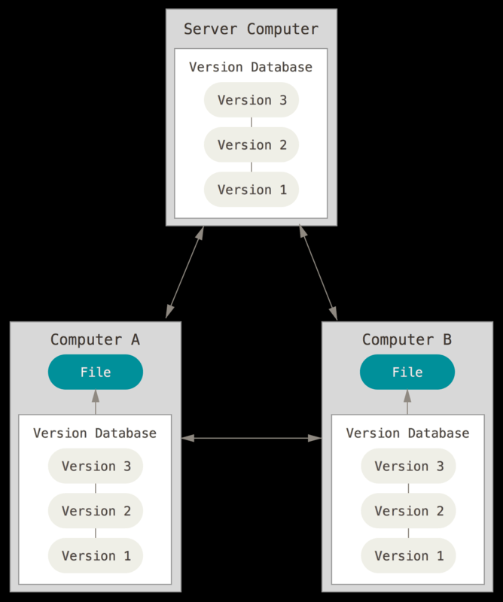
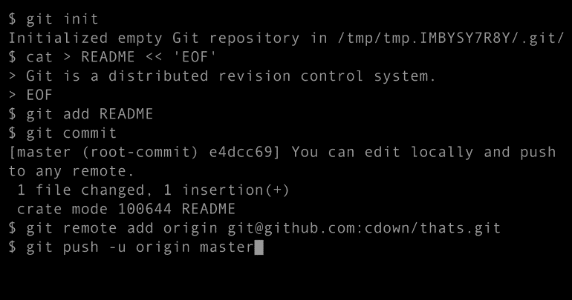


Git/GitHub Desktop
“Distributed version-control system for tracking changes in source code during software development”
Distributed Version Control Systems fully mirror the repository, including its full history. If any server dies, and these systems were collaborating via that server, any of the client repositories can be copied back up to the server to restore it. Every clone is really a full backup of all the data.
Git/GitHub Desktop help facilitate this process.

Slide 4
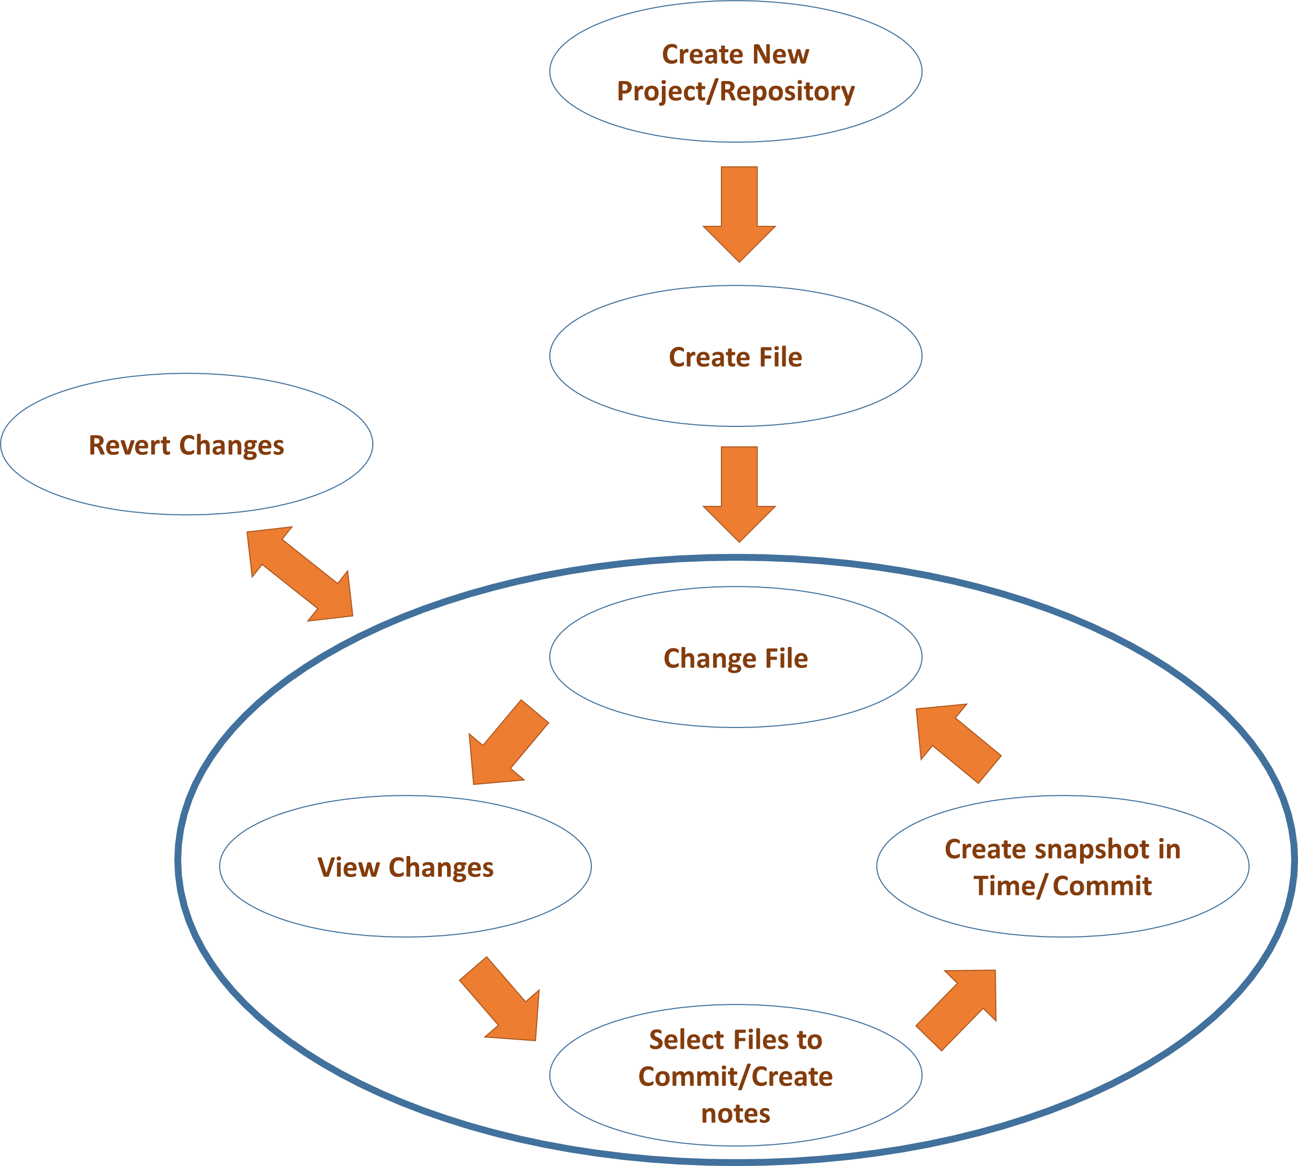
Typical Git Workflow

Slide 5
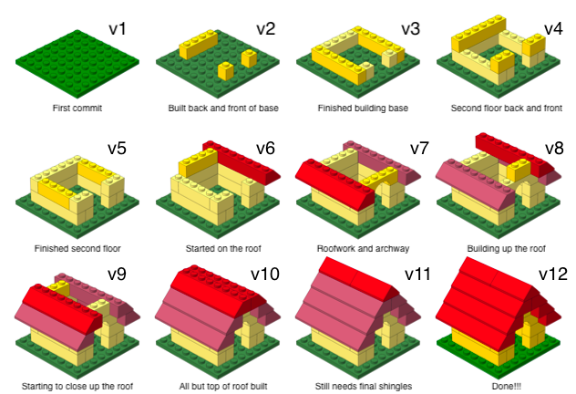
Creating Git Messages

Slide 6
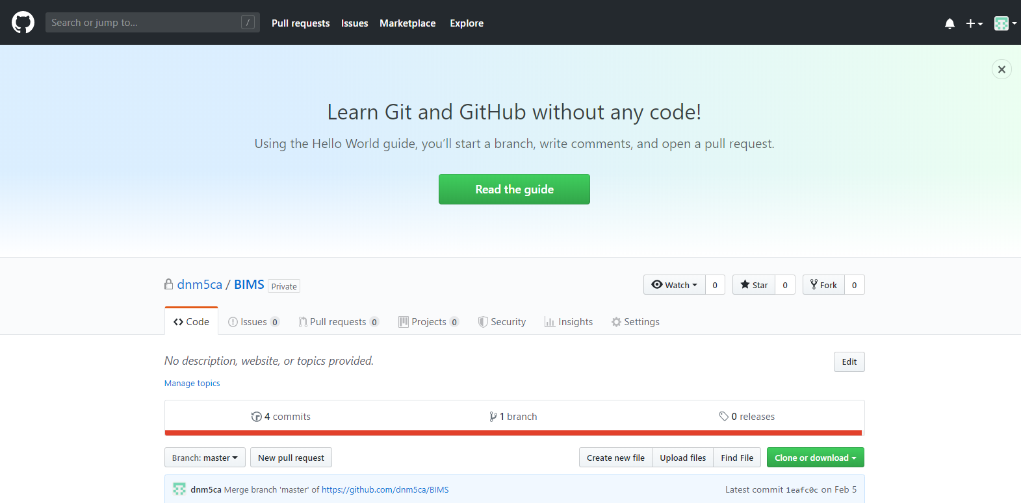

GitHub
Provides functionality on top of the normal Git infrastructure.
Web-based
Provides ability to Push-Pull objects from several repositories

Slide 7
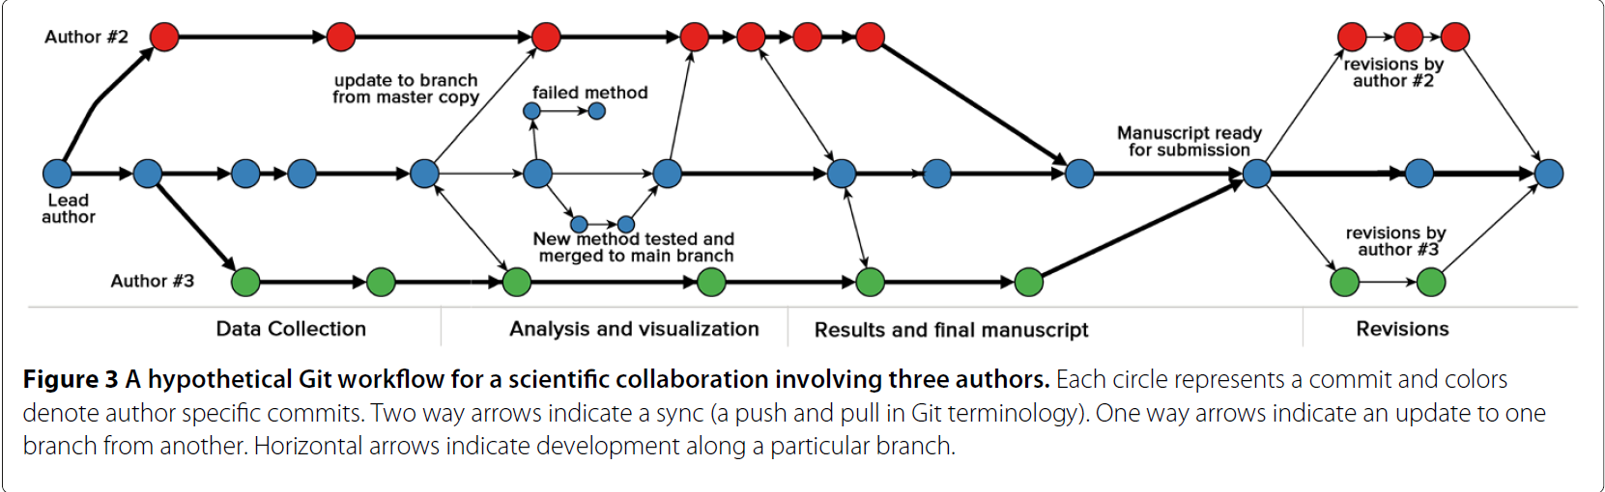
More Complicated Git Workflow

